Slide 1
Module 20 - Exercises
Training Modules for Applying the Mitigation Hierarchy:
Planning Policy and Projects for No Net Loss or a Net Gain of Biodiversity
Module 20
Exercises

Slide 2
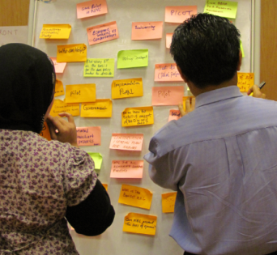
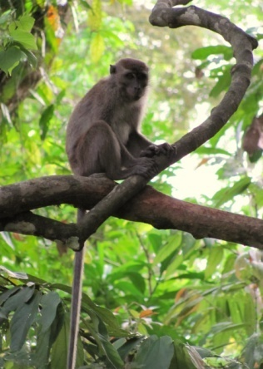
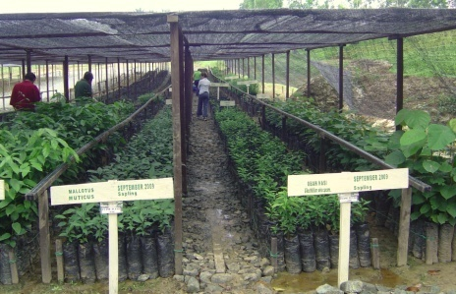
Which activities count towards a biodiversity offset?
What do you think?
Funding publication of conservation journal
Contributions to a Protected Area
Capacity building for Protected Area staff
Awareness raising for local communities
Conservation research
Set-aside an area that is not to be developed
Establishing a plant nursery of medicinal plants with local communities
Notes:
This is a simple ‘multiple choice’ type of exercise, where participants can say whether they think a particular action would constitute a part of an offset, and why – or why not they think this is the case.
Taking the measures in turn:
Funding publication of conservation journal? No. Why not? This would not result in ‘on the ground’ lasting biodiversity outcomes that achieve NNL relative to the impacts caused by a particular project. So, while it is a valuable contribution, it would not form part of an offset.
Contributions to a Protected Area? This depends. If the contributions lead to on the ground biodiversity outcomes that are a) additional (i.e. over and above what would have happened under a ‘business as usual’ situation for the PA) and b) lasting, and c) linked to the impacts according to the like for like or better rule, then such contributions could form part of an offset for a specific development project. Note that very rigorous evidence would be required to show in particular that the contributions are ‘additional’ and do not result in cost-shifting (i.e. Govt reducing the budget for the PA due to this new funding) would be required. Also note that this type of action is still actively being debated in international circles and that there is disagreement – i.e. Whether or not it could be regarded as part of an offset (even if all of the points noted above are met).
Capacity building for Protected Area staff? Generally not, if one is considering capacity building in and of itself. Capacity building as such will be very hard to link to clear, additional, lasting biodiversity outcomes on the ground. However, it could form part of an offset package, designed to deliver those outcomes relative to the biodiversity impacts by a project, with the aim of supporting the implementation of the offset.
Awareness raising for local communities? As above.
Conservation research? No, as above.
Set-aside an area that is not to be developed? Yes, but only if this is an area that can constitute an ‘averted loss’ offset and it is conserved for the long-term as a protected area (easement or similar) with associated funding and management sorted out.
Establishing a plant nursery of medicinal plants with local communities? Again, this is an action which could ‘tackle drivers of loss’ and therefore support the delivery of the requisite biodiversity gains for an offset by reducing the drivers of loss in an area conserved for the offset (and where people would otherwise collect medicinal plants in an unsustainable way). So the action could be part of an offset package that results in on-the-ground biodiversity outcomes and delivers NNL.

Slide 3
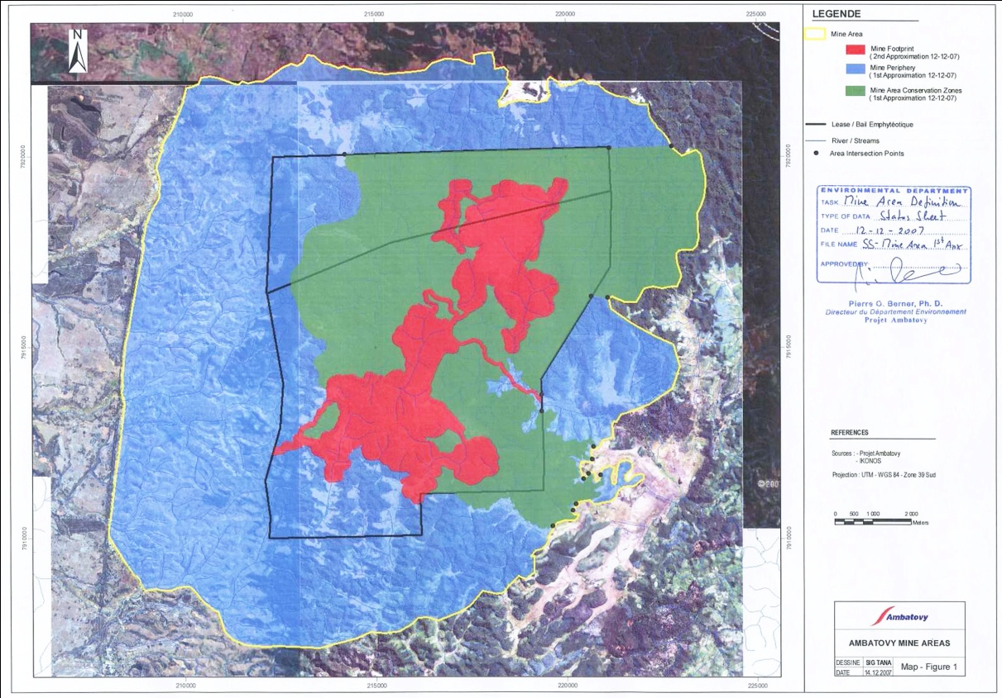
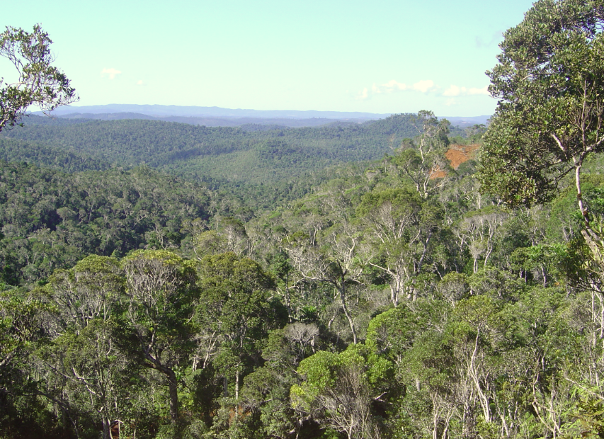
Exercise 1. Ambatovy Mitigation Hierarchy
No forest clearing above part of ore body
Securing area for long-term protection
Conservation management, monitoring
Alternative fuel wood sources for local communities to reduce pressure on forest
Actions at the mine site
‘Set-aside’ of conservation zones (on site):
Conservation forests: green
Mine lease area: blue
Mine footprint: red
Question:
Type of mitigation action?

Slide 4
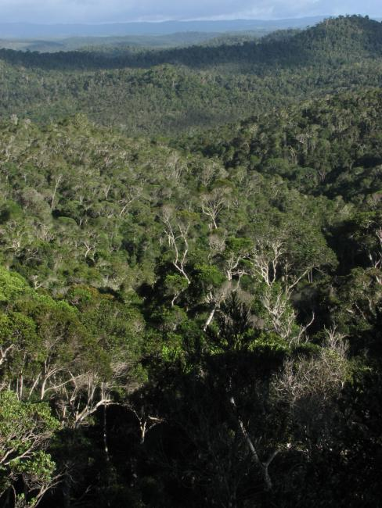
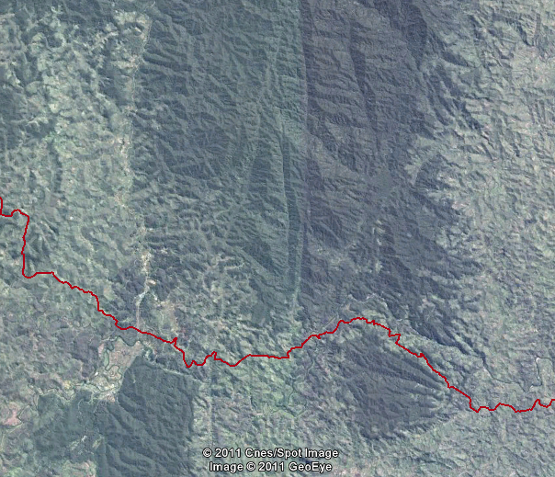
Exercise 1. Ambatovy Mitigation Hierarchy
2. Actions along the pipeline:
Routing of the pipeline to prevent impacts on tracts of forest that the pipeline would have crossed en route to the coast (e.g. Vohimana, and other areas)
[There is also scope to improve forest condition and to re-establish connectivity of natural areas in some places in this region (this is addressed on the next slide)]
Question:
Type of mitigation action?
Notes:
This action focuses on an area along the pipeline route: Here the company planned the pipeline routing in such a way as to avoid impacting on certain intact forest patches. It has not committed to conserving / formally protecting these patches (which are along the pipeline route, removed from the key mining areas).
The question is which type of mitigation measure are we seeing here? Since the company has not committed to formally conserving these areas, these actions constitute pure ‘avoidance’ of impacts. That is different from the previous set of actions.

Slide 5
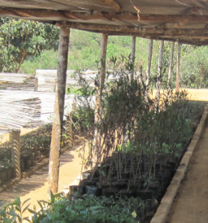
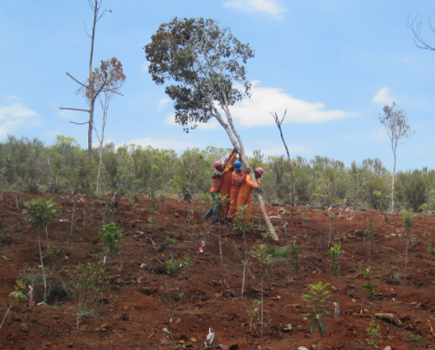
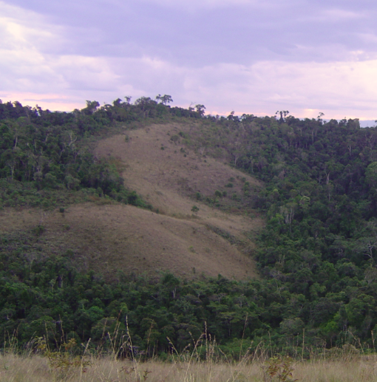
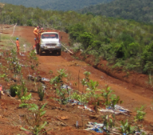
Exercise 1. Ambatovy Mitigation Hierarchy
3. More actions along pipeline
Restoration of forest and of areas degraded due to construction once laying of pipeline completed
→ to re-establish pre-impact condition
Restoration of a previously degraded area (not impacted by project) along pipeline
→ to improve connectivity with other forest patches
Question:
Type of mitigation action?
Additionality?
Notes:
Here we are considering restoration…. But there are two different types of actions involved here (listed in the grey box).
Are they the same in terms of where they fit into the MH?
Answer: No they are not. The first set of actions fits into the mitigation hierarchy as the ‘restoration’ step – this is because they are simply restoring or fixing an area of impacts caused by the company itself in laying the pipeline.
The second set of restoration actions could constitute one of the company’s offset measures, because they are aimed at fixing areas not impacted by the company itself, but are intended to create biodiversity gains (better forest condition, connected forest patches) in other areas. If these areas were incorporated as part of more formally protected areas, to ensure their long-term conservation in the face of threats surrounding them, these actions and areas could constitute part of the company’s offset.

Slide 6
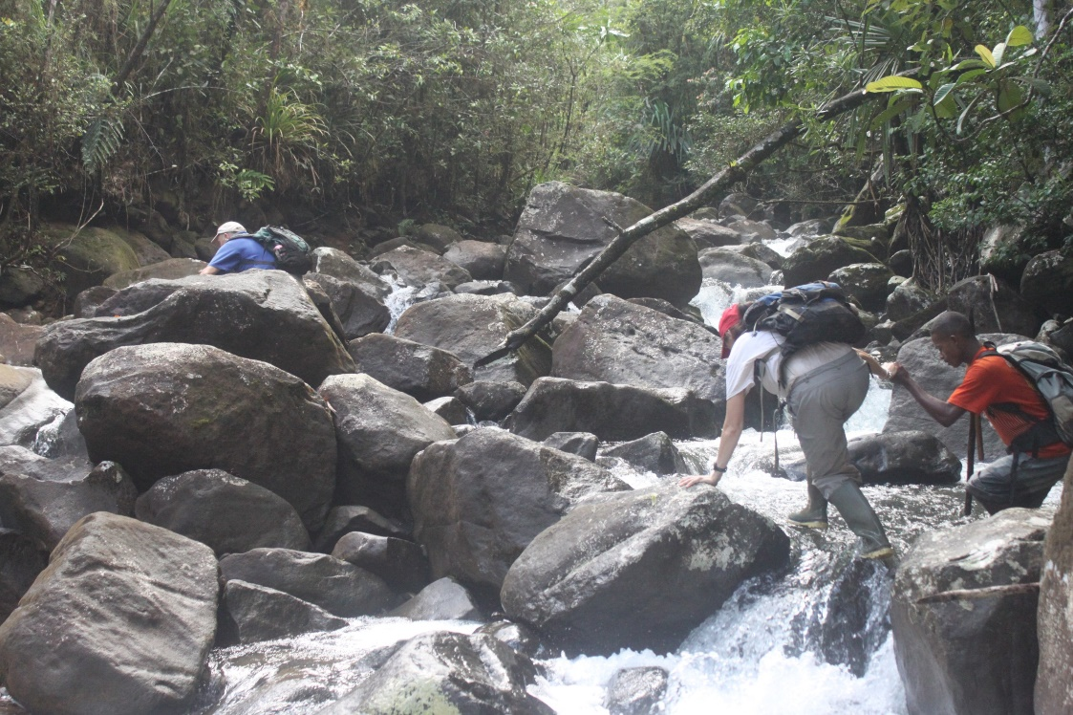
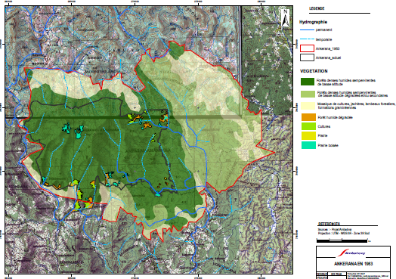
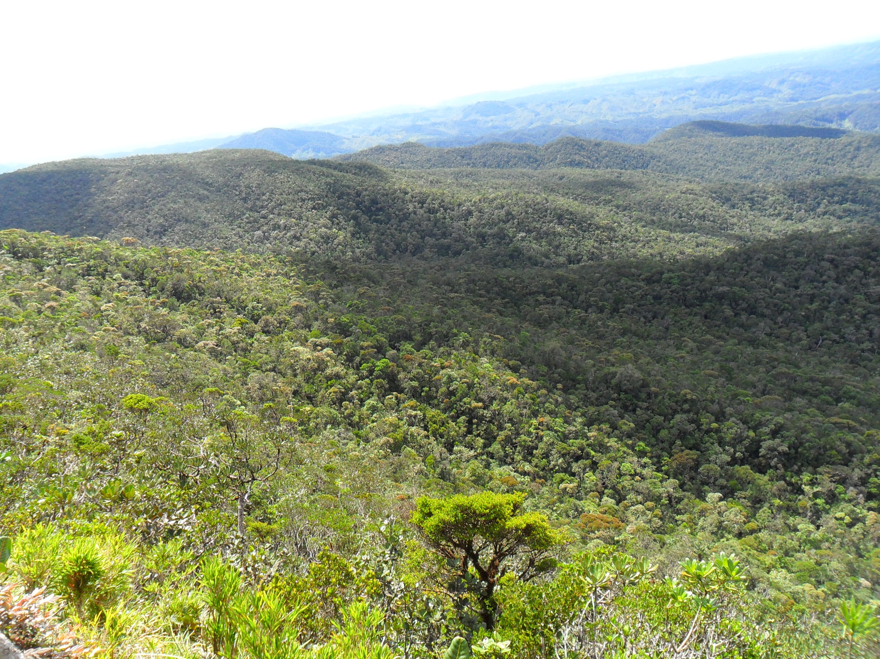
1. Ambatovy Mitigation Hierarchy
4. ACTIONS at Ankerana
Long term protection of large forest block 70km away from Ambatovy
Area selected on the basis of similarity to Ambatovy, and risk of loss (high rate of deforestation observed)
Ankerana of very high regional and national conservation significance
Slated as a new protected area by govt, but to date only temporary protection, and no budget allocated
Questions:
Type of mitigation action?
Additionality?
Notes:
This is the last set of actions, focused on a site that is around 6000 ha in size and part of a larger tract of forest recognised as a conservation priority for Madagascar. This forest is in relatively high condition, has similar biodiversity as that at the mine site, and is under threat mainly from slash and burn agriculture from poor communities living in the area. The company has been active in this area, to tackle drivers of loss and to ensure the gazetting of the area as a formal PA, and is working with the local communities and other partners (e.g. NGOs) to conserve Ankerana.
The Question is – what type of actions are these?
Answer: This is what one would typically consider as an ‘averted loss’ offset, where conservation measures implemented by the company and partners (including formal protection, financial provisions, management, etc) are intended to ensure the protection of an area under threat. These actions are over and above (additional) to what would be expected under a business as usual scenario, where the forest areas would be progressively cleared. Evidence for this background rate of loss (to demonstrate the ‘business as usual scenario) and the ‘averted loss’ contribution of the offset are essential to show that the actions part of a defensible offset that meets the ‘additionality’ requirements of an offset.

Slide 7
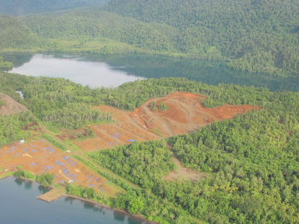
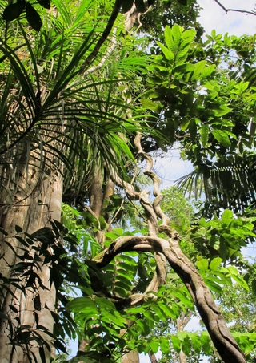
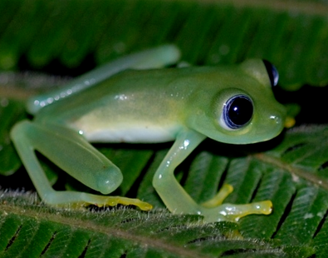
Exercise on No Net Loss (NNL)
IDENTIFY in the case of the Gold Mine and 4 different scenarios whether or not NNL is likely to be achieved!
Project side (Predicted LOSSES)
Gold mine with 1200 ha footprint Direct impacts (clearance) on humid forest and native grasslands, and on populations of several Red-Listed species of fauna and flora Indirect impacts on sensitive wetlands and streams – biodiversity and water use negatively affected Local communities rely on fish and water from streams in the catchment
Notes:
The aim of this exercise on NNL is to identify whether in the following scenarios NNL can be achieved. So, we are given a specific set of impacts by a gold mine and 4 different scenarios that set out what the company proposes doing to address (and possibly offset) its impacts. Are these proposals likely to lead to NNL?
First the predicted impacts (see box). This is of course a generalised picture for the exercise, and this set of predicted impacts remains the same throughout. It’s the actions to address the impacts that vary from one scenario to the next.

Slide 8
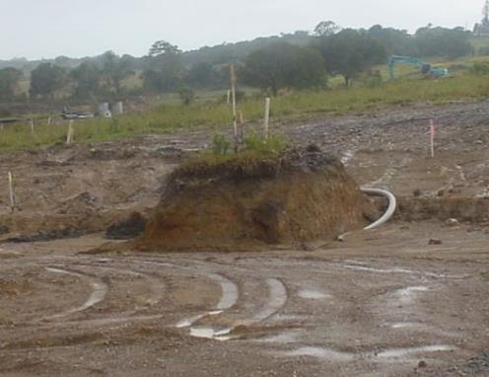
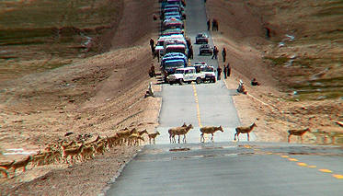
Exercise on the mitigation hierarchy
In your experience, do mitigation measures always work ?
e.g. What about the measures illustrated below?
Avoidance of impacts on a plant species?
Underpass for fauna
Notes:
[TRAINERS – We suggest you raise these questions as a small exercise with participants.]
Potential answer to the question on the slide:
An age-old problem with EIAs is known as the ‘mitigation myth’, when project proponents suggest mitigation measures that are actually unrealistic and stand little chance of succeeding in practice. The two photos here are illustrations. On the left, a single bush has nominally been ‘avoided’, but given the devastation around it, the bush will stand little chance of survival. What may have looked like satisfactory avoidance on paper plans will not work in reality. Similarly, the image on the right hand side shows another mitigation measure that is not working. Close to the parked cars, you can see a culvert that has been designed supposedly to allow the endangered ungulates to cross underneath the road. However, the culvert is too small and frightening for them, so they ignore it and continue to cross the road, running the risk of being killed by traffic. On this occasion, you can see the police holding up the traffic to allow the animals to cross, but over time, this photo suggests that the proposed mitigation measure (tunnels under the road to allow the animals to cross) will not have the claimed effect of avoiding and minimising loss.

Slide 9
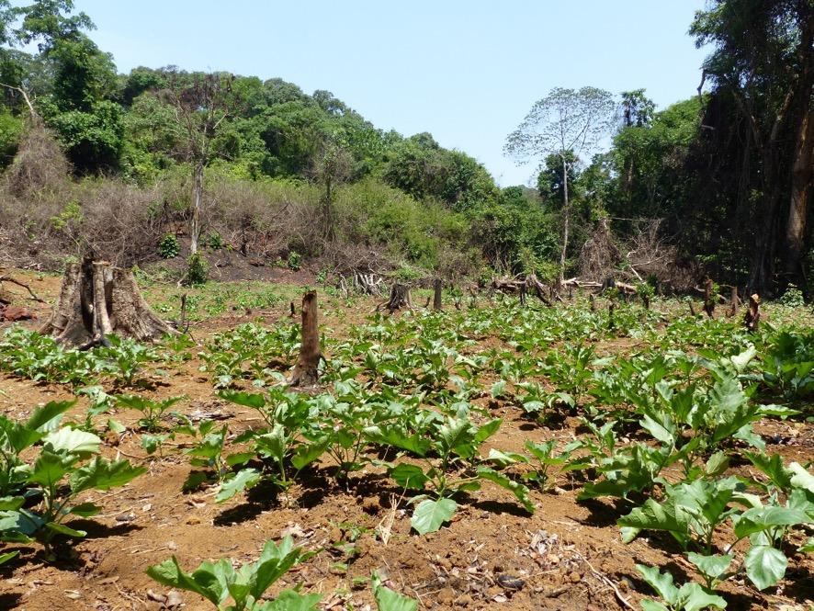
Exercise on the mitigation hierarchy
Do the mitigation measures illustrated below really work?
Ecological restoration?

Slide 10
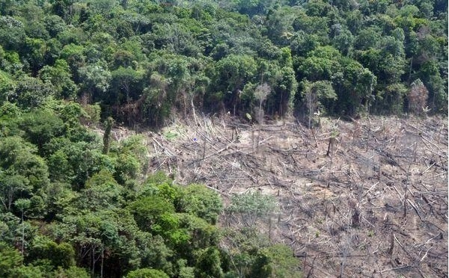
Exercise on the mitigation hierarchy
Continuing with frequently asked questions !
On what basis can we consider that protecting forests generates a "gain" of biodiversity?
What should we do to set-asides so that they can be considered as offsets?
Does restoring part of the project site (e.g. part of the mine site) count towards an offset ? Why or why not ?
Notes:
[TRAINERS – We suggest you raise these questions as a small exercise with participants.]
Potential answers to the questions on the slide:
This question is about ‘averted loss’ and demonstrating a gain in biodiversity outcomes relative to the counterfactual – i.e. in this case that the forest which is being protected through an offset would otherwise have been degraded and/or lost due to pressures that can be shown to threaten its persistence.
Taking the example presented in the case study earlier: The set aside at Ambatovy is BOTH avoidance AND an offset. (It’s avoidance because the company set aside and didn’t impact an area it had permission to mine, preventing loss. It’s also an offset, because the company is undertaking positive conservation management activities on the site (where no conservation was happening before) and putting in place legal and financial measures to ensure the protection of the area for the future.
Restoration in AREAS AFFECTED by the mine is the third step in the mitigation hierarchy. Restoration of degraded habitat in areas that were NOT affected by the mine is a way of generating conservation gains as part of an offset (provided the restoration activities satisfy ‘like for like or better’).

Slide 11
Exercise: Is it an offset?
Deals with residual impacts |  | Deals with all impacts
Contributes to conservation awareness |  | Creates measurable, on the ground results for conservation
Addresses biodiversity specifically |  | Addresses economic issues and risks
Looks at representative aspects of biodiversity |  | Financial contribution, measured in monetary terms
Reduces a project’s biodiversity impacts (but doesn’t necessarily counterbalance them) |  | Designed to achieve NNL, i.e. aims fully to counterbalance impacts
Only interested in plant and animal species |  | Interested in ecosystems, species and people’s use and cultural values of biodiversity
Can be used instead of avoid and minimize? |  | Must be used after avoid, minimize and restore?
Only company and government involved? |  | Responsibility and involvement of all stakeholders?

Slide 12
Exercise: Is it an offset (answers)
Deals with residual impacts | ✔ | Deals with all impacts | ✘
Contributes to conservation awareness | ✘ | Creates measurable, on the ground results for conservation | ✔
Addresses biodiversity specifically | ✔ | Addresses economic issues and risks | ✘
Looks at representative aspects of biodiversity | ✔ | Financial contribution, measured in monetary terms | ✘
Reduces a project’s biodiversity impacts (but doesn’t necessarily counterbalance them) | ✘ | Designed to achieve NNL, i.e. aims fully to counterbalance impacts | ✔
Only interested in plant and animal species | ✘ | Interested in ecosystems, species and people’s use and cultural values of biodiversity | ✔
Can be used instead of avoid and minimize? | ✘ | Must be used after avoid, minimize and restore? | ✔
Only company and government involved? | ✘ | Responsibility and involvement of all stakeholders? | ✔

Slide 13
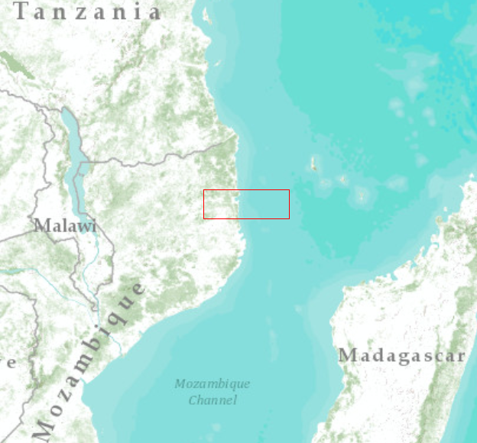
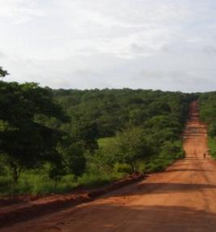
MOZOG MH & offset planning
Proposed project:
Offshore Natural gas Project (and LNG Plant), Northern Mozambique
Off-shore drilling rigs/platforms
Pipeline connecting rigs to the coast and LNG plant
On-shore LNG plant & Port
Associated infrastructure, facilities (roads, quarry, etc.)
Corporate NNL commitment for the project
Baseline studies and ESIA well underway
Project location

Slide 14
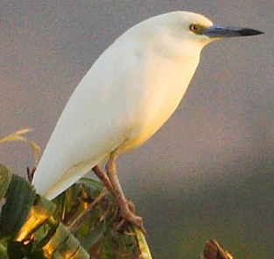
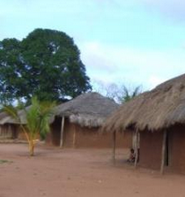
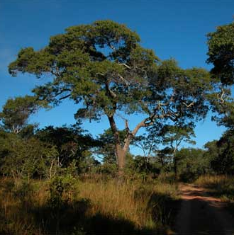
MOZOG MH & offset planning
Predicted impacts include:
Loss & degradation of > 2000 ha vegetation (woodlands, coastal forest, scrub/grassland dambos)
Loss & degradation of coral reefs, unique coastal lagoon system (and cave of spiritual significance), Green sea turtle nesting habitat (one of 8 sites globally) and IUCN-listed Madagascar Pond Heron
Potential degradation (sedimentation) of river and impacts on quality of water used by communities.
Photo Adam Ridley

Slide 15
MOZOG MH & offset planning
Stakeholders, financing
Public stakeholder meetings held with local communities, NGOs Naturalia, Biofondo, government authorities (e.g. PA authorities), others
Several positive contributions and opportunities have been identified, but there are also some major concerns:
In particular, Naturalia opposes the project on the basis of its predicted impacts on coral reefs and green turtle nesting sites. The NGO does not believe that NNL can be achieved if there are impacts on these biodiversity components.
Various lenders are interested in financing the project. This includes several Equator Banks, who require adherence to the IFC’s PS6 and the other Performance Standards – covering both social and environmental practices.

Slide 16
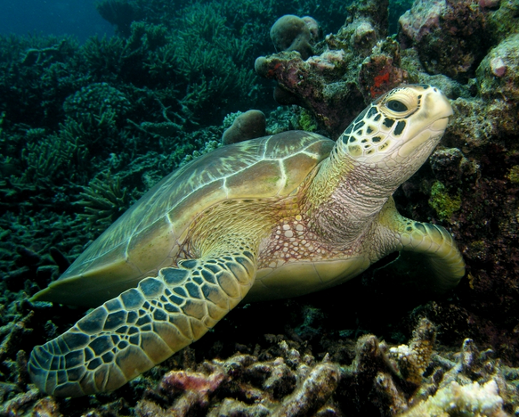
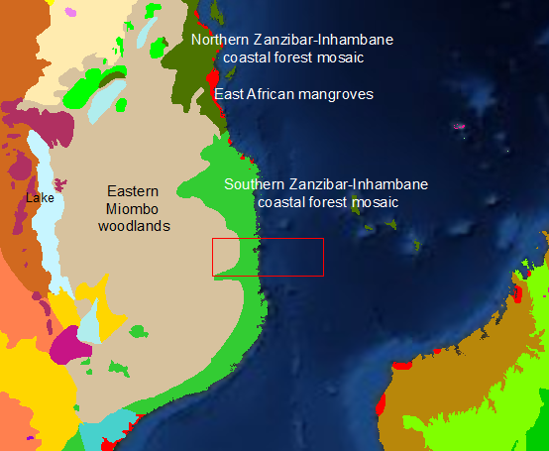
MOZOG MH & offset planning
Regional context:
Small, scattered villages, people with subsistence lifestyle (heavily reliant on fishing, small scale agriculture, use of water from rivers), recent population influx
Mosaic of different vegetation types (Status from Least Threatened Miombo woodlands to Vulnerable, Endangered Forest, Dambos)
Important aquatic biodiversity:
Two rivers, wetland systems, coastal lagoon
Turtle nesting sites, coral reefs
Small underfunded protected area in the South , potential to expand this
Diverse land tenure (leases)

Slide 17
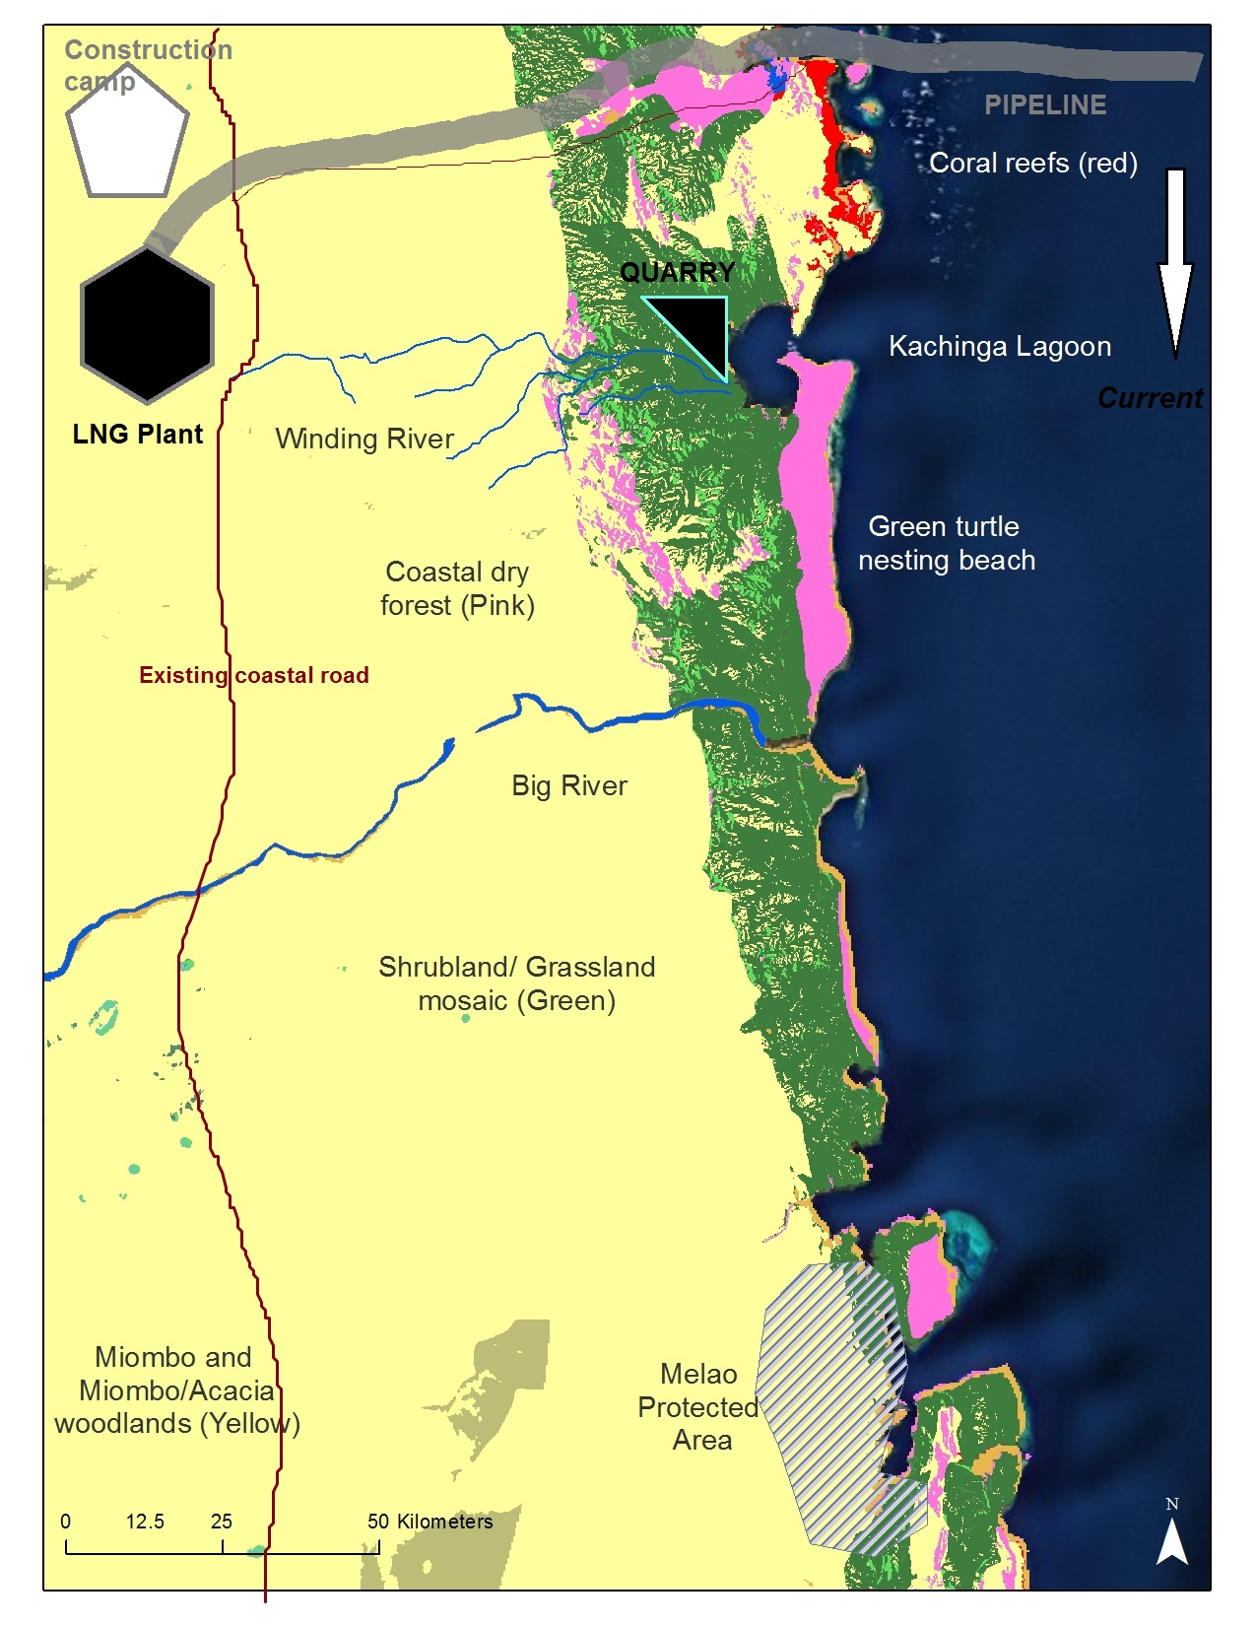
MOZOG MH & offset planning
Landscape context:
The Proposed project and surroundings
Villages

Slide 18
MOZOG MH & offset planning
What does Mozog need to do to satisfy its NNL commitment for the proposed project, especially concerning impact avoidance, minimization and biodiversity offsets?
Group work
Materials: Maps, background information sheet
Consider the key guiding questions to start investigating how Mozog could meet NNL
Please report back

Slide 19
MOZOG MH & offset planning
Key guiding questions
Which project impacts does Mozog need to consider? (Remember that direct, indirect and cumulative impacts should be considered). Are all of the predicted residual impacts likely to be capable of being offset (i.e. can you identify any potential ‘fatal flaws’)? Would you recommend redesigning the project (e.g. to avoid ‘fatal flaws’), and if so, how might this be achieved? How will the mitigation hierarchy be applied, and what are some key mitigation measures you would recommend? [What opportunities and constraints exist for offsets in the region?]

Slide 20
Exercício: Preparar TdR do EISA
De volta ao Mozog!
Foram detidas as primeiras reuniões com as partes interessadas ​​e potenciais credores e foram levantadas as principais preocupações;
Como Director de Ambiente da Empresa, você percebe que o EIA actual (versão preliminar) não será suficiente, dados os requisitos dos credores internacionais;
Você decide elaborar novos TdR para o EIA, de forma a cobrir a PS6 da IFC (no contexto da PS1);
É-lhe disponibilizada a PS6 e a Norma BBOP para revisão. Tal irá ajudar com a tarefa de identificar os principais aspectos a serem incluídos nos TdR.
→ Em pequenos grupos, debata e discuta o que precisa de ser incluído nos novos TdR.
→ Elabore uma lista de pontos para cobrir os passos e questões que os seus consultores terá de cobrir como parte do EIA.

Slide 21
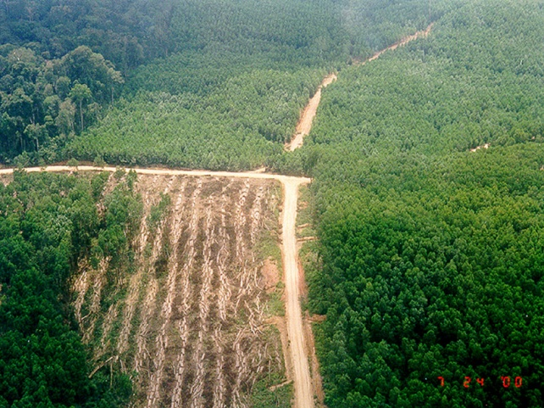
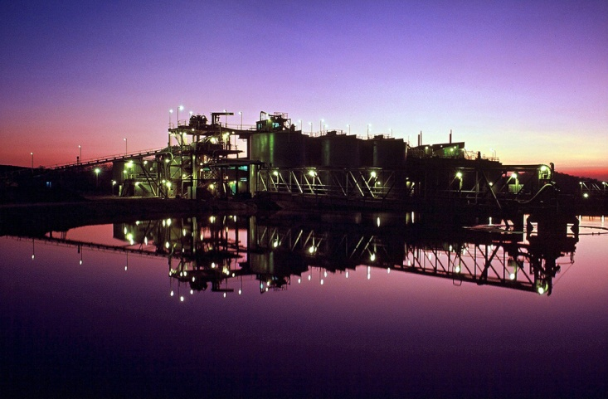
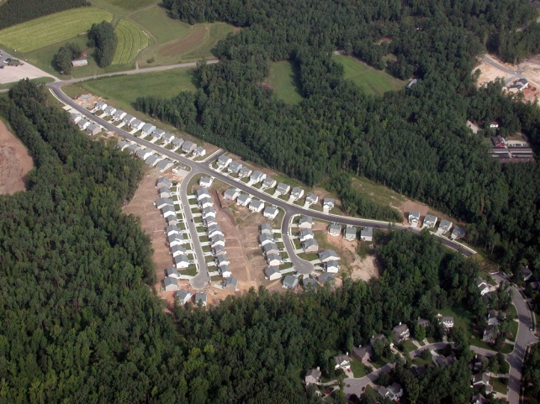
Exercício 3: Implementação dos Contrabalanços
Perguntas/tarefas para os participantes:
Você conhece três opções diferentes de implementação (ver próximo slide):
locais de um único contrabalanço ou compensação,
locais de contrabalanços agregados ou compensação,
bancos de conservação
É-lhe dada informação sobre 3 situações (A, B, C, descrita nos slides seguintes), onde existe oportunidade para desenvolver contrabalanços ou compensações de biodiversidade
Combine as três situações para obter a opção de implementação mais apropriada!
Situação A: Óleo de Palma
Situação B: Mina de Ouro
Situação C: Habitação

Slide 22
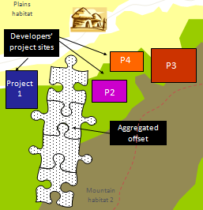
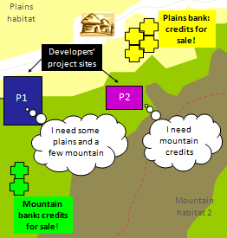
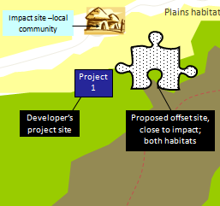
Exercício 3: Implementação
Aqui estão as três opções de implementação de contrabalanço/compensação de biodiversidade:
Opção 1: Local (individual) único | Opção 2: 2 Local agregado | Opção 3: Bancos de conservação
Abordar os impactos residuais de um único projecto Demonstrarresultados adicionais mensuráveis de conservação | Um contrabalanço/compensação está previsto para abordar os impactos de vários projectos A necessidade de contrabalanço/compensação é conhecida antecipadamente Concebido para compensar os impactos específicos de biodiversidade | Os créditos de biodiversidade são estabelecidos antes de quaisquer prejuízos para os quais possam ser utilizados para contrabalançar/compensar Concebido para fornecer contrabalanço/compensação ao longo do tempo, para colmatar múltiplas perdas

Slide 23
Exercício 3: Implementação
Situação de Impacto | Situação A (Empresas de Óleo de Palma na Indonésia) | Situação B (Mina de Ouro na África Central) | Situação C (Projectos de Habitação na Austrália)
Tipo de Contrabalanço | Contrabalanço/Compensação agregada | Contrabalanço/Compensação Único | Bancos de Conservação
Porquê? | Várias empresas Impactos agregados de natureza semelhante Oportunidade para uma conservação mais eficaz e eficiente através de um contrabalanço agregado Nenhum candidato bancário Capacidade e recursos governamentais limitados, para fornecer sistemas potenciadores | Empresa única impactos residuais significativos Nenhum desenvolvimento adicional previsto Oportunidades para o desenvolvimento de contrabalanços com parceiros locais | Impactos significativos de vários projectos Previsível (projectos planeados para durarem muito tempo) Projectos e impactos agregados Ambiente institucional e regulatório potenciador Uma empresa vê uma oportunidade de desenvolvimento

Slide 24
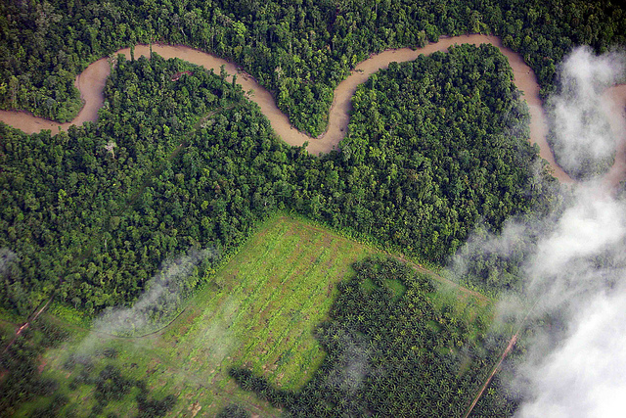
Exercício 4: Planeamento ao Nível da Paisagem
Descrição da situação:
Planeada uma expansão em grande escala das plantações de palma para uma região ha 5 milhões de hectares na Colômbia
Várias empresas multinacionais envolvidas, algumas delas pediram financiamento à IFC, são membros da RSPO e/ou não têm política de nenhuma perda líquida (NPL) - comprometido com as melhores práticas sociais e ambientais, incluindo contrabalanços de biodiversidade
Cada empresa tem várias concessões de terras diversas, cobrindo em conjunto ~30% da paisagem
A região é actualmente um mosaico de usos da terra rural (cultivo, povoações, etc.), alguns dos quais são extensos, mas a produtividade é baixa
O governo não tem planos detalhados de ordenamento do território para a região e gostaria de ver um desenvolvimento bastante rápido em toda a região, não só da agricultura, mas também do turismo de natureza
http://www.forestjustice.org/2010/11/20/the-weekend-wow-palm-oil-plantations-cutting-into-the-papuan-jungle-is-the-amazon-next/

Slide 25
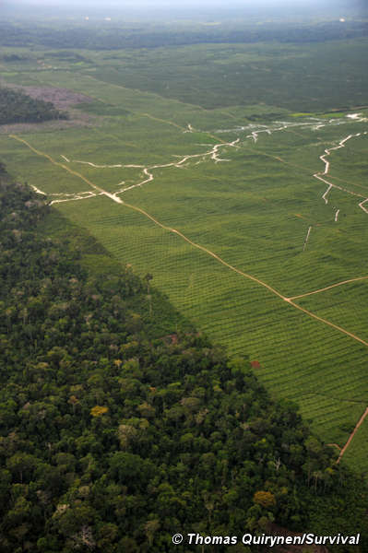
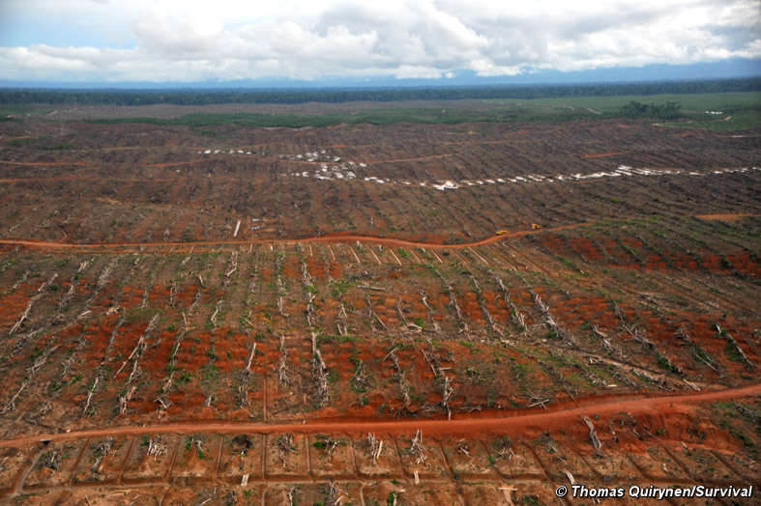
Exercício 4: Planeamento ao Nível da Paisagem
Papel do Fundo Ambiental (FA):
As suas experiências em países vizinhos mostra que uma expansão rápida, em grande escala, das plantações de palma poderão causar enormes danos ambientais e perda de biodiversidade, a menos que sejam seguidas boas práticas ambientais e sociais
Também reconhece tal situação como uma oportunidade de envolver o sector privado, e de vincular o desenvolvimento agrícola e trabalho de conservação na região.
Pode iniciar discussões com as empresas e o governo sobre a necessidade, finalidade e processo de planeamento para NPL de biodiversidade em toda a região. Você quer convencer as outras partes da importância de fazer o planeamento antes de desenvolver a área.
Tarefas:
- Identificar os benefícios do planeamento da paisagem para a biodiversidade e expansão agrícola na região, e as oportunidades que podem resultar de um bom planeamento; e
- Identificar os riscos de não fazer o planeamento da paisagem.

Slide 26
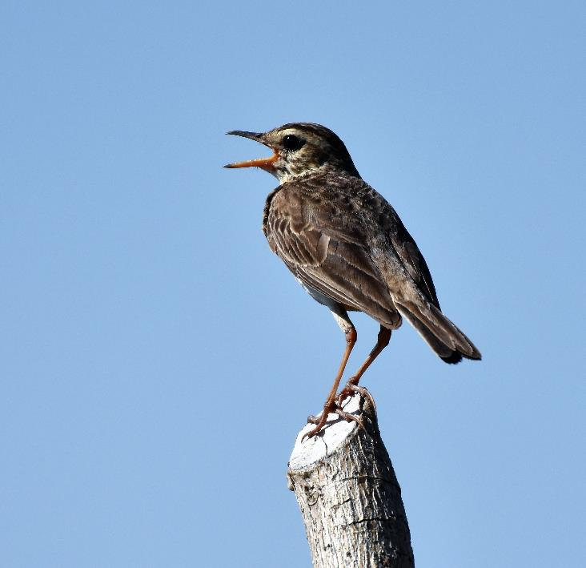
Exercise: Check whether management actions are well-defined
Each group analyses a set of actions to assess if they are good enough
Written?
Dated?
Impact-specific?
Measurable?
Achievable?
Reasonable?
Timely?
Understandable?

Slide 27
Exercise: Table for analysis
 | Action 1 | Action 2 | Action 3
Written?
Dated?
Impact-specific?
Measurable?
Achievable?
Reasonable?
Timely?
Understandable?

Slide 28
Exercise: Table for analysis
 | Action 1 | Action 2 | Action 3
Written?
Dated?
Impact-specific?
Measurable?
Achievable?
Reasonable?
Timely?
Understandable?

Slide 29
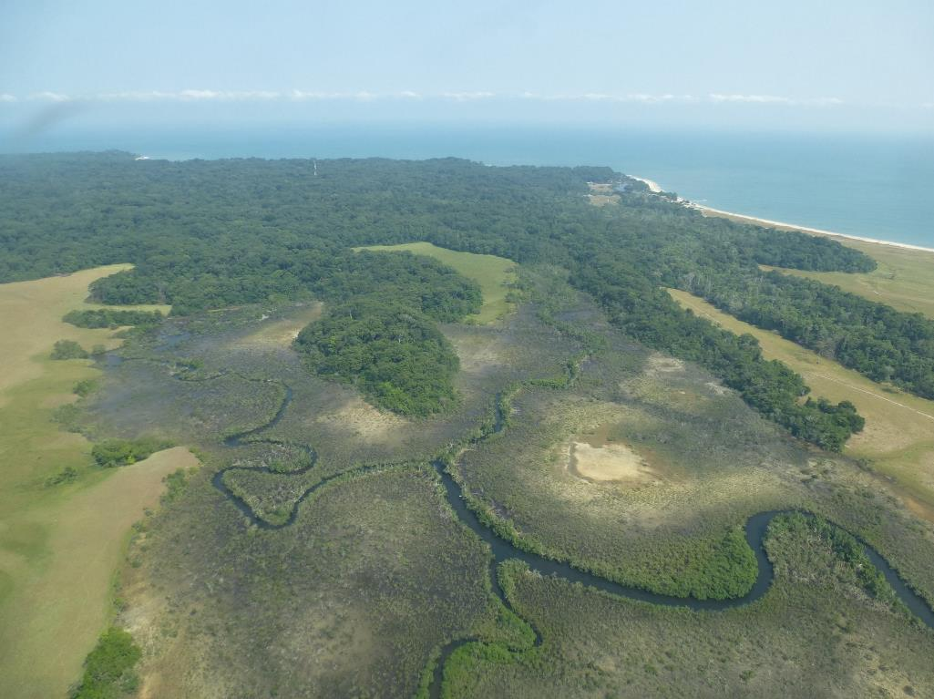
Exercise: check if EMP governance is well described
Each group analyses a set of actions to assess if they are good enough
Does the EMP indicate who will prepare the terms of reference for actions?
Does the EMP indicate who will be signing contracts with suppliers / service providers?
Is technical assistance needed?
Will experienced and skilled staff be involved in implementation?
Is the necessary equipment described?
Is independent monitoring planned?
Is the decision making process for corrective action described?
Is government auditing included in the EMP?

Slide 30
Exercise: EMP governance - Table for analysis
 | Action 1 | Action 2 | Action 3
Who prepares the TOR?
Who signs contracts?
Technical assistance?
Required staff experience and skills?
Required equipment?
Independent monitoring of action?
Process for corrective action?
Audits?

Slide 31
Are impacts temporary or permanent?
Project effect on biodiversity | Temporary | Permanent
Destruction of habitat
Loss of access to habitat (fragmentation)
Increased mortality of animals
Water pollution
Noise pollution
Dust deposits
…

Slide 32
Exercise: check if monitoring plan is appropriate
Each group analyses a set of monitoring actions to assess if they are good enough:
Link to impacts and mitigation measures?
Indicators and their justification?
Thresholds and their justification?
Sampling locations?
Sampling frequency?
Person responsible?
Trigger for corrective action?

Slide 33
Exercise: Table for analysis
 | Action 1 | Action 2 | Action 3
Link to impacts & mitigation measures?
Indicators and their justification?
Thresholds and their justification?
Sampling locations?
Sampling frequency?
Person responsible?
Trigger for corrective action?

